Slide 1
Analytical Study of Surfaced Enhanced Raman Scattering in Ag-Pyridine nanostructure using LAMMPS
Author: Soham Chatterjee

Slide 2
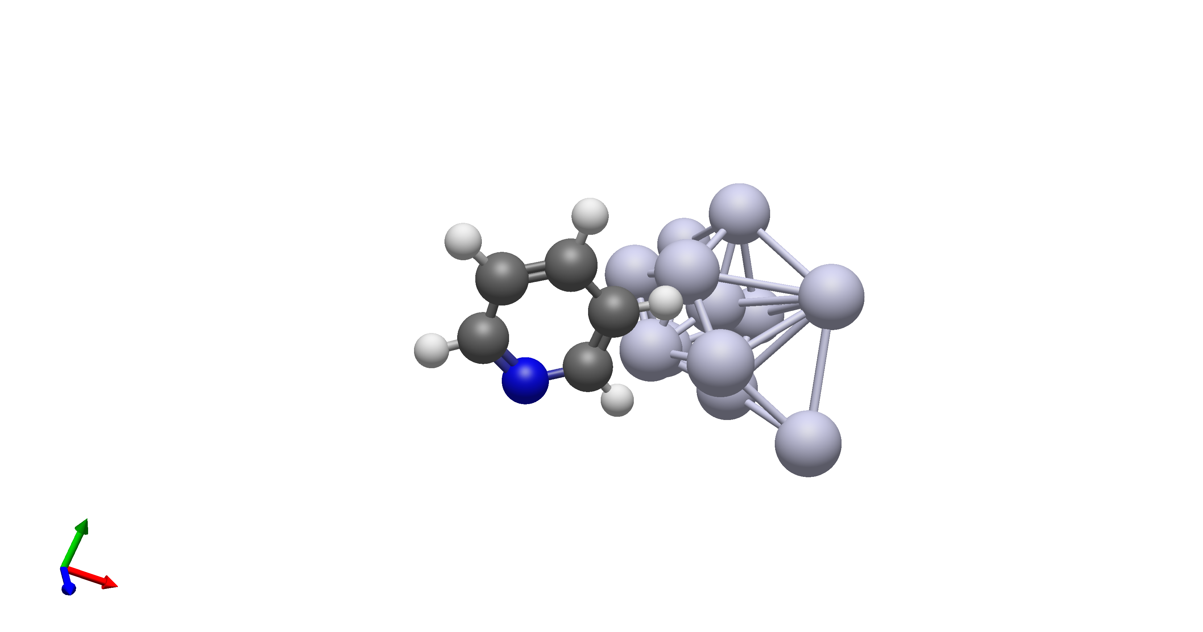
ABSTRACT :
The ability to simulate surface-enhanced Raman scattering (SERS) is a vital tool in elucidating the chemistry of molecules near the vicinity of plasmonic metal nanoparticles. In this experiment, I have simulated a nanostructure consisting of Silver (Ag) icosahedra dimer with a single pyridine molecule on its surface at 300K temperature via LAMMPS . Velocity Autocorrelation dataset is obtained at first which is Fourier transformed to get the vibrational density of states dataset which in turn helps us get an understanding of the Raman Active Vibrational modes. The approach used is entirely classical and helps us analyze how the classical interaction between silver and pyridine affects the raman scattering effect.

Slide 3
INTRODUCTION AND METHODOLOGY
One of the unique properties of plasmonic metal nanoparticles is their ability to enhance and concentrate the electromagnetic field at the surface of the particle. This leads to a large enhancement of the optical properties of molecules in the vicinity of the metal surface, which can be exploited in surface-enhanced spectroscopic techniques such as surface-enhanced Raman scattering (SERS). Since its discovery and identification, SERS has become a multidisciplinary tool. The large enhancement due to the metal particles enables the detection and identification of single molecules, and a recent study has demonstrated that it is possible to achieve sub nm resolution from the Raman imaging of individual molecules.
LAMMPS follows an entirely classical mechanic approach to to simulate the interaction between metal nanoparticle and pyridine molecule which helps us study the SERS spectrography. We have used Langevin thermostat to run the simulations at 300K and computed the velocity autocorrelation factor at every 100 timesteps. Our experimental setup consists of of a silver icosahedra dimer (Ag24) and a Pyridine molecule on its surface (C5H5N). Python Numpy and Pandas have been used to obtain the Vibrational Density of States data and plot it at the same time. Experimentally we can get the Raman Intensity values corresponding to the vibrational frequencies, and Computationally we have obtained the vibrational frequencies dataset which correspond to the respective Raman Intensities. A tally of the 2 different output sets can be made for verification of either. Leonard Jones potential have been used for all molecular interactions (modified with Waldman–Hagler (WH) combining rule) except Silver- Silver interactions for which EAM force fields have been defined.

Slide 4
RAMAN INTENSITY
R.I is directly proportional to dP/dq
{where R.I is Raman Intensity, P Is polarizability tensor and q is vibrational coordinate}
Thus greater the change in Polarizability during a specific vibrational motion means greater Raman Intensity or that particular vibrational mode.
We filter out the dominant vibrational frequencies from the VDOS plot obtained as Raman activity can be observed only for those dominant vibrational frequencies ( where peaks are observed)
A molecule with N atoms has 3N-6 vibrational modes and each vibrational mode corresponds to a normal mode characterized by specific frequency and displacement pattern. Raman Scattering is basically inelastic collision of photons wherein frequency shift occurs for the plasmonic metal nanostructure used corresponding to vibrational energy levels.
R.I = K* (v0-v)^4 * |dP/dq|^2
Where K is proportionality constant, v0 is excitation frequency and v is vibrational frequency.

Slide 5
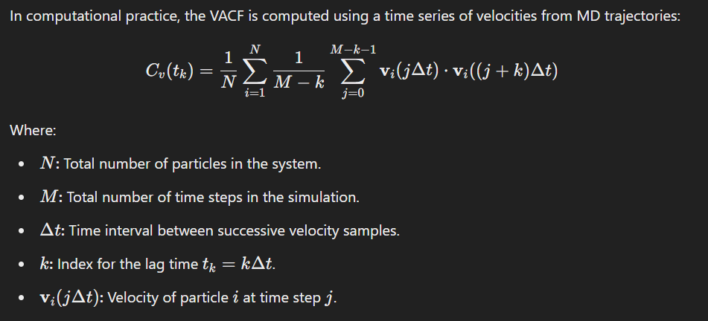
VELOCITY AUTOCORRELATION FACTOR
It is basically a measure of how velocity of particles correlate with themselves over time.
C​(t)=⟨v(0)⋅v(t)⟩
Applications of VACF:
Diffusion Coefficient: The diffusion coefficient D can be computed using the Green-Kubo relation
Spectral Density: The Fourier transform of C (t) gives the vibrational density of states
J(ν)=∫Cv(t)*exp(-i2πνt) dt
4.Transport Properties:
VACF is used to study viscosity, thermal conductivity, and other transport phenomena.

Slide 6
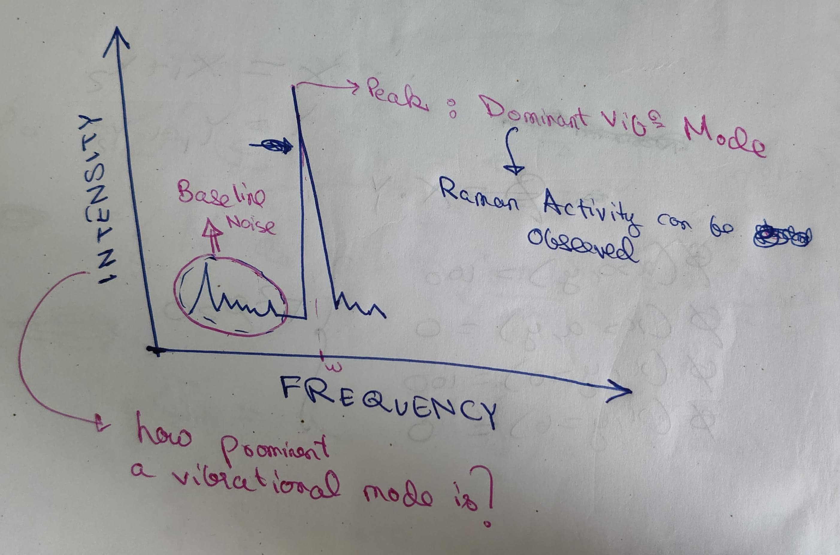
VIBRATIONAL DENSITY OF STATES
VACF is the time axis output of Molecular Dynamics software and VDOS can be understood as the frequency correspondence of the same. Thus, VDOS is obtained as the Fourier Transform of VACF.
The VDOS is defined as the number of vibrational modes per unit frequency. For a given system, it provides a way to understand the spectrum of vibrations that atoms or molecules can exhibit.
Physical Interpretation
Each vibrational mode corresponds to a normal mode of motion, such as stretching, bending, or torsion.
The VDOS reveals which vibrational frequencies dominate in a system, providing insights into its dynamical and thermodynamic properties.
Characteristics of VDOS
Peaks in the VDOS correspond to characteristic vibrational frequencies of the system.
The intensity of a peak indicates the number of modes or their strength at that frequency.
Broad peaks suggest damping or disorder, while sharp peaks indicate well-defined vibrations.
We filter the dominant frequencies from the VDOS plot (the frequencies at which peaks are observed), since it is only for these active vibrational frequencies that Raman Spectra would be observed.

Slide 7
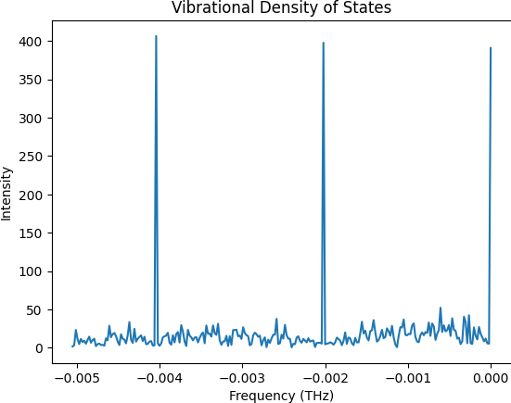
KEY FINDINGS
This is the VDOS plot for a silver icosahedra dimer nanostructure with no surface enhancement. Dominant frequencies can be observed near -0.004 THz, -0.002 THz and 0.000 THz approximately. From the accurate dataset obtained we can filter out the dominant frequencies and proceed further on with Raman calculations.
SILVER ICOSAHEDRA DIMER WITH NO SURFACE ENHANCEMENT

Slide 8
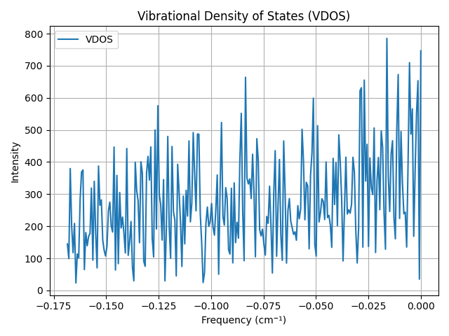
This plot is for Silver Icosahedra dimer with pyridine enhanced surface. The X Axis represents wavenumber in cm-1 units.
Silver Icosahedra dimer with pyridine enhanced surface

Slide 9

CONCLUSION AND FUTURE SCOPE
On comparing the 2 obtained plots, clearly it can be seen that the presence of pyridine on surface enhances the raman scattering effect intensely. There is a significant increase in dominant vibrational frequencies in the second plot which contribute to the raman effect. This is due to the surface enhancement factor of Pyridine and the obtained result is a consequence of the classical interaction between silver nanostructure and pyridine molecule.
Further, Raman intensities can be obtained by computing the polarizability derivatives for the dominant frequency modes. This can be carried out in ORCA or Gaussian.
Also, the lifetime of the dominant vibrational modes can be computed as :
An analytical study can be performed as it is known that Raman intensity is directly related to the lifetime of vibrational modes; longer lifetimes lead to higher Raman intensity, particularly at resonance, where the intensity is determined by the exciton lifetime

